Slide 1
Single Phase Induction Motor
Dept. of Electrical & Electronics Engg., MIT - Manipal

Slide 2
Introduction
Construction is similar to 3 phase induction motor except the stator has TWO winding - starting & running.
The rotor is of squirrel cage type
A capacitor is connected in series with the starting winding to achieve phase split.
The motor is started as two phase machine.
Dept. of Electrical & Electronics Engg., MIT - Manipal

Slide 3
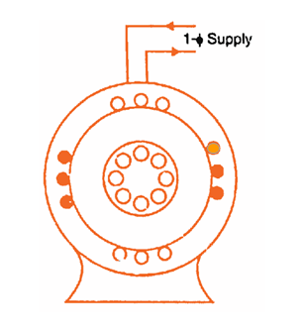
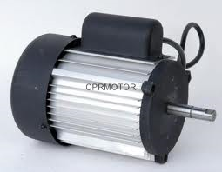
Construction
Stator
Rotor
Dept. of Electrical & Electronics Engg., MIT - Manipal

Slide 4
Working Principle –Double field revolving theory
Torque, Nm
Torque due to forward field T_{F}
Resultant field is alternating. Hence,
Single Phase induction motors are Not Self Starting in nature
Resultant Torque
Slip, %
2
1.5
1
0.5
0
Torque due to reverse field T_{B}
Dept. of Electrical & Electronics Engg., MIT - Manipal

Slide 5
Starting
The motor is started as two phase induction motor
Phase split is achieved by connecting a series capacitor with starting winding
Types
Capacitor Start Motor – pump / compressor motors
Capacitor Run Motor – ceiling fan motor
Dept. of Electrical & Electronics Engg., MIT - Manipal

Slide 6
Capacitor Start Motor
Starting Winding
Centrifugal Switch opens the circuit when speed is near about rated speed
Capacitor present in circuit only at starting
I_{st}
I₁
I_{st}
Capacitor
φ_{st}
Centrifugal
Switch
V
V
I_{m}
φ_{m}
I₁
I_{m}
Rotor
Main Winding
Dept. of Electrical & Electronics Engg., MIT - Manipal

Slide 7
Applications
Low power applications such as Air conditioners, Pumps, Fans.
Refrigerators, Washing Machines etc…
Dept. of Electrical & Electronics Engg., MIT - Manipal

Slide 8


Summary
Three phase Induction motors have inherent self- starting torque . It can never run at synchronous speed.
Single phase Induction motors are used for small power applications The common forms are capacitor start and capacitor run motor.
Dept. of Electrical & Electronics Engg., MIT - Manipal

Slide 9


Basic Electrical Technology [ELE 1051]
L28- Synchronous Motors & ENERGY METERS

Slide 10
Topics Covered
Synchronous Motors
Introduction
Construction
Working Principle
Applications

Slide 11
Synchronous Motors
Dept. of Electrical & Electronics Engg., MIT - Manipal

Slide 12
Introduction
Synchronous motors are constant speed AC motors which always run at synchronous speed irrespective of connected load.
Its power factor of operation is controllable.
Field system is DC excited or made up of permanent magnets
Synchronous condensers are used for power factor improvements.
Dept. of Electrical & Electronics Engg., MIT - Manipal

Slide 13
Construction
Stator
Has slots on the inner periphery to accommodate the armature windings
Rotor
Carries the field windings that produces the required flux.
Dept. of Electrical & Electronics Engg., MIT - Manipal

Slide 14
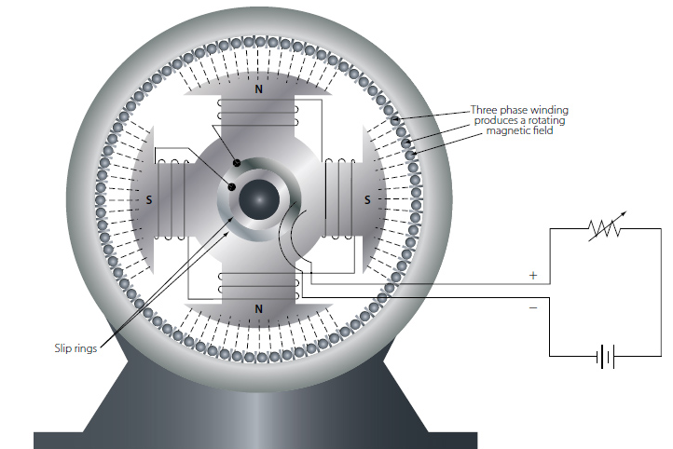
Construction
Stator
Armature conductors
Rotor
Field windings
Dept. of Electrical & Electronics Engg., MIT - Manipal

Slide 15
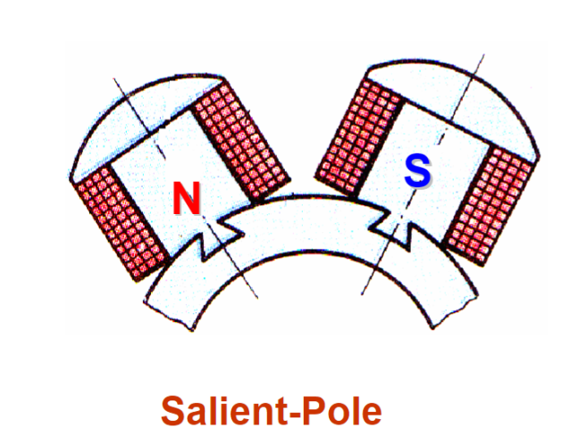
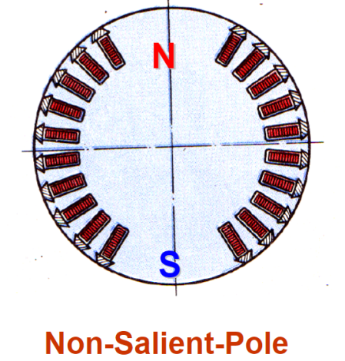
Construction
Synchronous machines are of two types based on the rotor structure
Salient pole type
Low speed applications
Cylindrical Rotor Type
Robust and used for high speed applications
Dept. of Electrical & Electronics Engg., MIT - Manipal

Slide 16
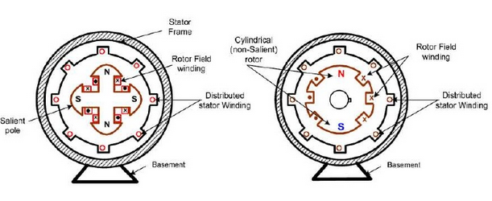
Construction
Salient Pole
Non Salient Pole

Slide 17
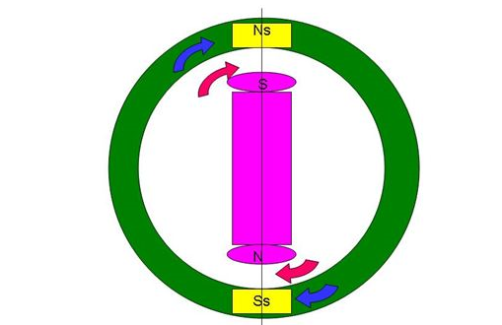
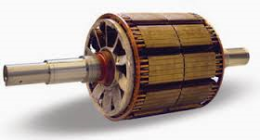
Principle of Operation
Armature energized from a 3 phase ac source , and the machine is started as induction motor with damper windings.
After achieving the full speed, field winding is excited and the stator and rotor field gets magnetically locked.
Rotor with damper windings
Rotor poles get locked to the unlike poles in the stator .Torque is now unidirectional
Dept. of Electrical & Electronics Engg., MIT - Manipal

Slide 18
Power Factor Control
By varying excitation current one can change the operating power factor.
With normal excitation unity power factor can be achieved.
Under excited synchronous motor operates with lagging power factor.
Over excited synchronous motor operates with leading power factor - Synchronous Condenser
Dept. of Electrical & Electronics Engg., MIT - Manipal

Slide 19
Applications
Constant speed applications
Used for power factor improvement
Dept. of Electrical & Electronics Engg., MIT - Manipal

Slide 20
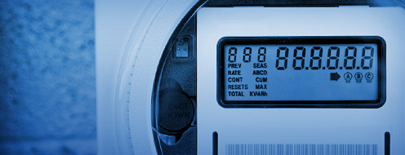
Energy Meters

Slide 21
Topics Covered
Working Principle of Energy Meters
Introduction to Digital Energy Measurement
Electricity Tariff

Slide 22
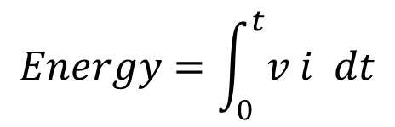
Working Principle
Energy is the total power delivered or consumed over a time interval,
Energy = Power x Time
Electrical energy developed as work or dissipated as heat over an interval of time ‘t’ may be expressed as:
$$Energy=\int_{0}^{t}{v i dt}$$
v – Applied voltage in (volts)
i – current (A)
t – time (hr)
Unit of Energy: kWh
Notes:
Power is the rate at which energy is used (or generated). A watt is one joule of energy per second. For example, if a 100 watt light bulb is turned on for one hour, the energy used is 100 watt-hours (W·h) or 0.1 kilowatt-hour, or (60x60x100) 360,000 joules. This same quantity of energy would light a 40-watt bulb for 2.5 hours. A power station would be rated in watts, but its annual energy sales would be in watt-hours (or kilowatt-hours or megawatt-hours). A kilowatt-hour is the amount of energy equivalent to a steady power of 1 kilowatt running for 1 hour, or 3.6 megajoules
https://www.bijlibachao.com/electricity-bill/online-electricity-bill-calculator-for-all-states-in-india.html#util
https://www.bijlibachao.com/electricity-bill/what-are-watt-kilowatt-and-a-unit-of-electricity.html

Slide 23
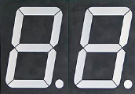
Digital Energy Meter
Phase
Neutral
Current
Sensor with Signal Conditioner
Display
Voltage Sensor with Signal Conditioner
Processor
Analog
Multiplier
ADC

Slide 24
Three Phase Digital Energy Meter
Phase
Neutral
Current
Sensor with Signal Conditioner
Display
Voltage Sensor with Signal Conditioner
Processor
Analog
Multiplier
ADC

Slide 25
Electricity Tariff
Installation | Power Supply | Tariff
Industries | 11kV and above | Demand Charges (per kVA) Power Factor Surcharge (per unit) Energy Charges (per kWh)
Hotels/Restaurant/ Cinemas/Petrol Bunks/Banks/ Commercial Complexes | 400V Three Phase 230V Single Phase | Sanctioned Load (per kW) Power Factor Surcharge (per unit) Energy Charges (per kWh)
Residential | 400V Three Phase 230V Single Phase | Sanctioned Load (per kW) Energy Charges (per kWh) Rebate for Solar Installations
Reference: MESCOM ‘Electricity Tariff-2014’ dated 06/05/2014
Notes:
Power Factor surcharge for Industries:
The specified P.F. is 0.90. If the power factor goes below 0.90 Lag, a surcharge of 3 Paise per unit consumed will be levied for every reduction of P.F. by 0.01 below 0.90 Lag.
Power Factor surcharge for Commercial:
If the PF is found to be less than 0.85 Lag, a surcharge of 2 Paise per unit consumed will be levied for every reduction of P.F. by 0.01 below 0.85 Lag. In respect of LT installations, however, this is subject to a maximum surcharge of 30
Paise per unit.

Slide 26
Summary
Synchronous motors are constant speed AC motors which always run at synchronous speed. Synchronous condensers are used for power factor improvements.
Energy can be measured by integrating power over an interval of time.
Electricity Tariff depend on the type of consumer.

Slide 27
Course Summary: BET [ELE 1051]
DC Circuit Analysis:
Circuit elements, Sources, Resistance, Inductance, Capacitance, Mesh Current and Node Voltage Analysis, Superposition, Thevenin’s and Max Power Transfer Theorems
Magnetic Circuit Analysis and Electromagnetism:
Magnetism, Laws of magnetism, series and parallel magnetic circuits, Electromagnetic induction, Magnetic coupling, induced emfs, mesh current equations
Single phase AC Circuit Analysis:
Generation, Representation, AC through R, L and C, Series and parallel circuits, Power, Power factor, Resonance in series and parallel AC circuits
3 phase AC Circuit Analysis:
Generation, Representation, Types of connection – Star & Delta, Analysis of balanced and unbalanced loads, Measurement of Power
Overview of Power System Components:
Electrical Power System – An overview, Generation, Transmission, Distribution, Utilization of Electric Power; Overview of Electrical Machines, Types, working principle & applications; Measurement of Energy: Energy meters

Slide 28
THANK YOU

